Slide 1
Introduction to Mechanisms and Machines
Theory of Machines
The theory of machines and mechanisms is an applied science that is used to understand the relationships between the geometry and motions of the parts of a machine or mechanism and the forces that produce these motions.

Slide 2
Machine
A machine is an apparatus for applying mechanical power, consisting of a number of interrelated parts, each having a definite function.

Slide 3
Structure, Mechanism and Machine
There is a direct analogy between the terms structure, mechanism and machine and the three branches of mechanics. The term ‘structure’ is to statics as the term ‘mechanism’ is to kinematics as the term ‘machine’ is to kinetics.

Slide 4
The parts of the machine are usually called elements, and two elements which are in contact, and between which there is relative motion, are known as a pair. An element joining two pairs is called a link or bar. If a group of links and pairs is capable of relative motion but can be made rigid by joining any two elements it is called a kinematic chain. If one of the links of a kinematic chain is ‘fixed’ the chain becomes a mechanism, and if a mechanism is used to transmit force it becomes a machine.

Slide 5
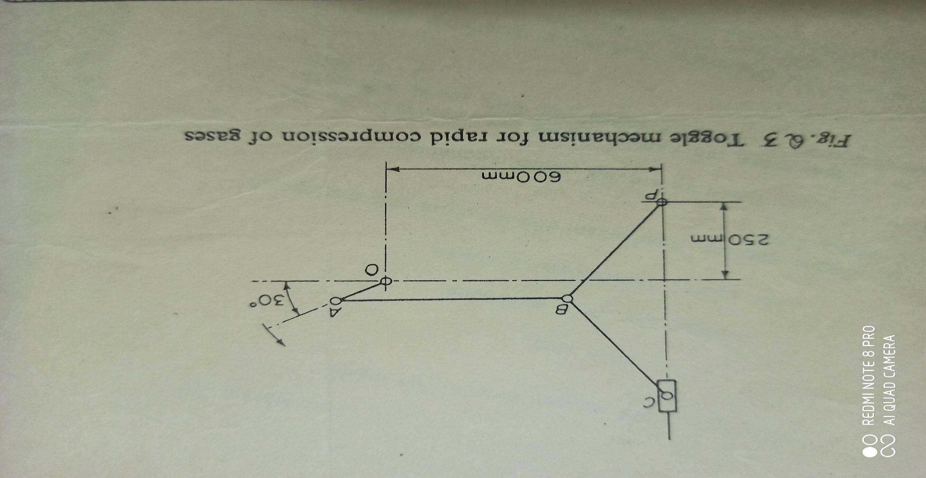
Conventions for representation: links/bar by straight lines; turning pair by small circle; piston/slider by rectangle; ‘fixed’ point by vertical cross; ‘fixed’ member by hatching.

